Slide 1
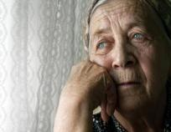


Stroke treatment gaps: men vs. women
Christine Kremer, associate professor Department of Neurology Skåne University Hospital Malmö/Lund, Department Clinical Sciences Lund University, Sweden

Slide 2
Why are gender differences in stroke important?
Differences in presentation
Stroke etiology
Risk factors in women, modifiable, non-modifiable, at what age?
Outcome, Recurrency, prognosis?

Slide 3
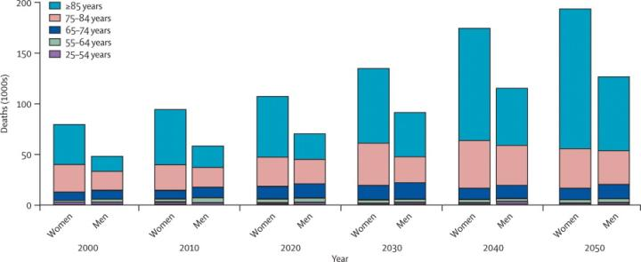
Mortality stroke projected numbers of deaths
Reeves, J,Bushnell, C
Lancet Neurology 2008. 10: 915-926.
Projected number of deaths from stroke among whites (USA, 2000–2050)

Slide 4
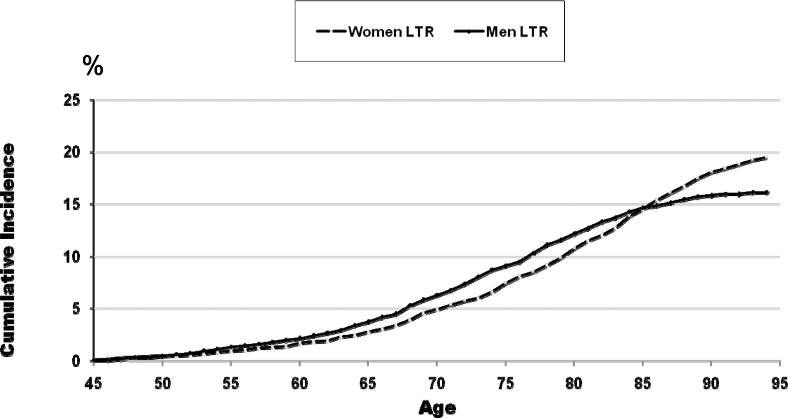

Gender-specific mortality-adjusted cumulative incidence (lifetime risk) of stroke.
Rodica E. Petrea et al. Stroke. 2009;40:1032-1037
Copyright © American Heart Association, Inc. All rights reserved.
Notes:
Figure 2. Gender-specific mortality-adjusted cumulative incidence (lifetime risk) of stroke.

Slide 5
Presentation and admission
Higher percentage of non-traditional stroke symptoms ¹
More stroke mimics
Treatment delay ²
¹Bushnell et al Lancet Neurology 2018, 17: 641-65; ² Mainz et al Stroke 2020 Aug;51:2332-2338

Slide 6
Sex differences prevention and treatment
Primary prevention ASA - ASA may be more effective
Intravenous thrombolysis- higher mortality- lower rate of independence
Endovascular therapy - lower rate of independence
Stroke prevention in atrial fibrillation - lower mortality in women treatment with DOAC
Kremer et al. Sex differences in prevention and acute treatment of ischemic stroke- a systematic review
and meta-analyses, unpublished, under review

Slide 7
Hemorrhagic stroke
Men > women (< 80) ( 132 vs. 98 ) ¹
Large global differences (asian > caucasian)
Outcome comparable (caucasian ² asian³)
Tendency towards better outcome in women ⁴ , perihematoma growth ⁵?
Reversed in women >80
Relative increase OAC related bleedings
¹ Suzanne Barker-Collo et al. Neuroepidemiology 2015;45:203–214; ² Arnstein Tveiten et al Eur Neurol 2012;67:240–245 ³ Shigematsu K et al. Acta Neurol Scand 2015: 132: 59–64; ⁴ Justin T. Hsieh PLOS ONE | DOI:10.1371/journal.pone.0152945; ⁵Wagner I et al. Eur J Neurol 2012, 19: 1477–1481

Slide 8
Subarachnoid hemorrhage
Women > men (1,24 - nearly doubled) smoking/hypertension/excessive alcohol consumption
Outcome comparable (adjusted data)^{1;2}
Complications
Delayed Ischemia tendency women > men ³(data limited)
¹ Ziemba-Davis M J Stroke and Cerebrovas Dis 2014; 5: 1073-1082;² Hamadan A et al. J Neurosurg 2014.121:1367–1373; ³de Rooij et al Stroke. 2013;44:43-54

Slide 9
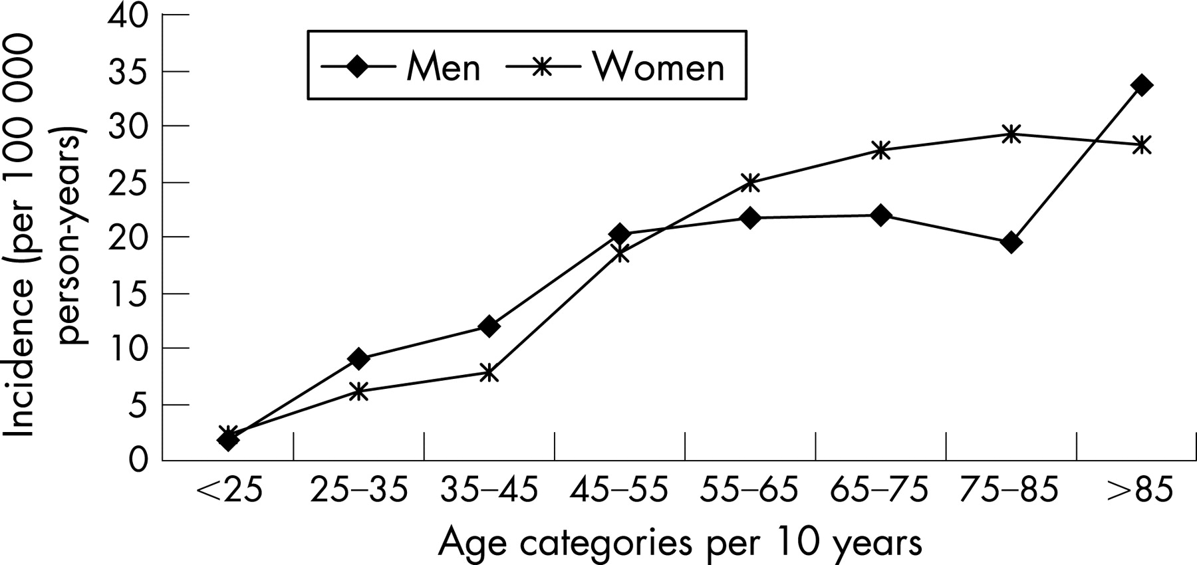

Incidence of subarachnoid haemorrhage by age and gender.
N K de Rooij et al. J Neurol Neurosurg Psychiatry 2007;78:1365-1372
Notes:
Incidence of subarachnoid haemorrhage by age and gender.

Slide 10


Ischemic Stroke etiology age - dependent
Older
Cardioembolic
Large artery atherosclerosis
Lacunar
Younger pregnancy- related- hormonal therapy
Cardioembolic
Large artery atherosclerosis
Unknown embolic source
Venous stroke
Sex Differences in First-Ever Acute Stroke
Roquer et al Stroke. 2003;34:1581-1585.

Slide 11
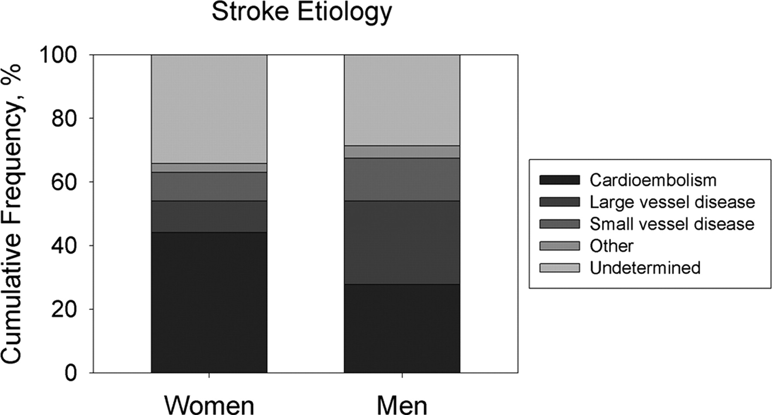
Alex Förster et al. Stroke. 2009;40:2428-2432
Copyright © American Heart Association, Inc. All rights reserved.
Notes:
Figure 2. Cumulative frequency of stroke etiology in women and men with AIS.

Slide 12
Younger vs. older women vs. men
Hormonal (estrogen) therapy - dose-dependant ¹(smoking/migraine)
Cerebral venous thrombosis – Puerperium - obesity, hormonal therapy ²
Migraine with aura - migraineous stroke? ³ (posterior circulation)
Reversible vasoconstriction syndrome (SAH/Stroke)
¹Roach RE et al Cochrane Database of Systematic Reviews 2015;²Zuurbier S et al JAMA Neurol. 2016 May 1;73(5):579-84. ³ K. Laurell et al Eur J Neurol 2011;18: 1220–1226; Anne Ducros et al. Brain 2007, 130: 3091-3101.

Slide 13
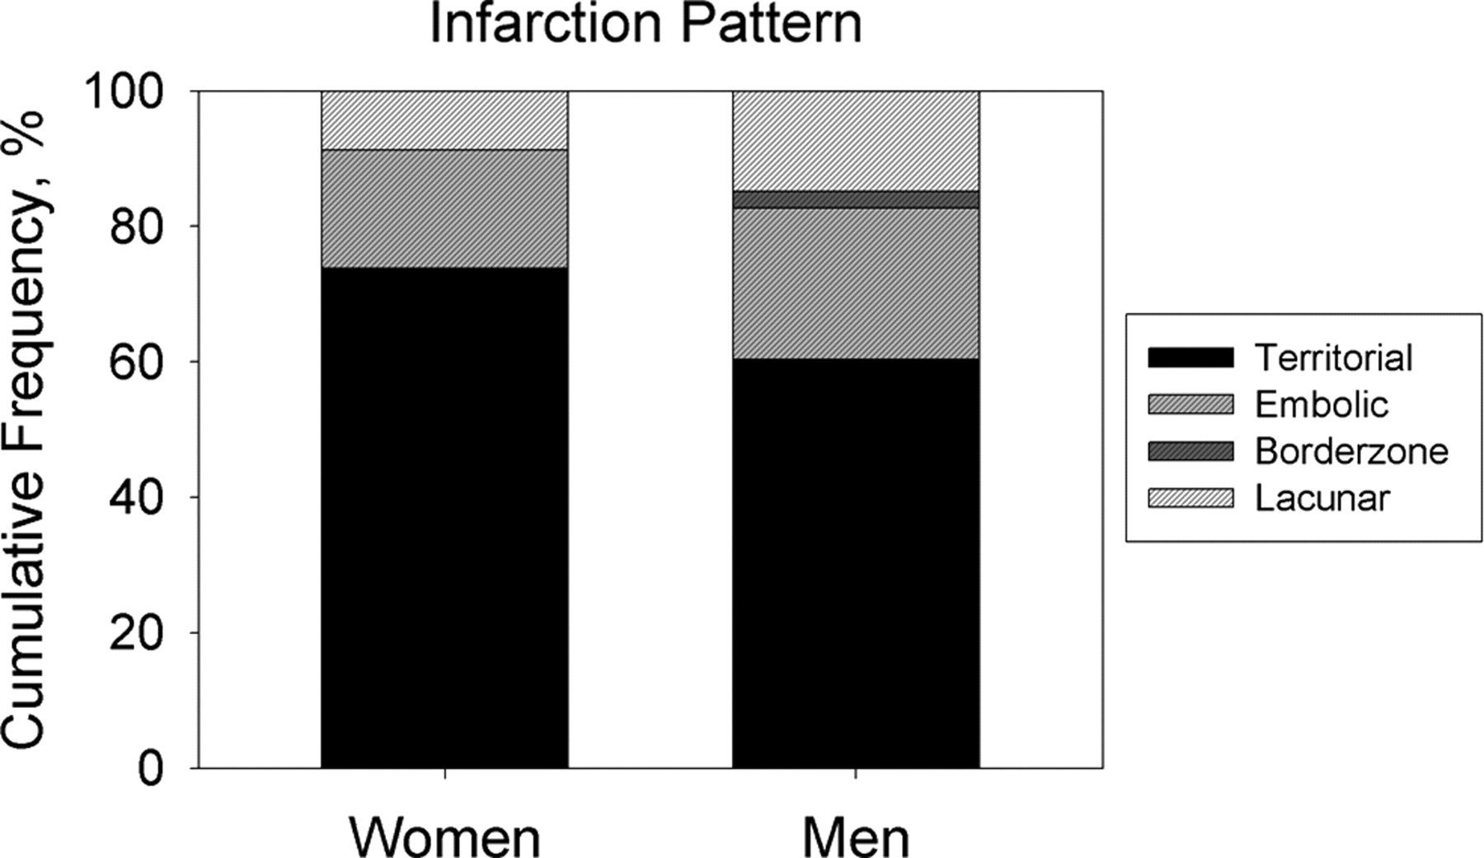
Type of stroke
Alex Förster et al. Stroke. 2009;40:2428-2432
Copyright © American Heart Association, Inc. All rights reserved.
Notes:
Figure 3. Cumulative frequency of different infarction patterns in women and men with AIS.

Slide 14
Women anterior vs. posterior circulation strokes
Anterior circulation stroke (embolic)
Women > men
Posterior circulation stroke(embolic/lacunar)
Men > women
Frid et al J Neurol. 2020 Mar;267(3):649-658

Slide 15
Stroke risk factors - modifiable
Blood pressure
Diabetes
Metabolic syndrome
Dyslipedemia
Smoking
Madsen et al, Focused update- Impact of conventional risk factors on stroke in women: an update Stroke 2018; 49, 3 : 536-542

Slide 16
Risk factors not-modifiable
Pregnancy, post-partum
Migraine w/ aura
Atrial fibrillation
Post-menopausal - Hormonal replacement therapy

Slide 17
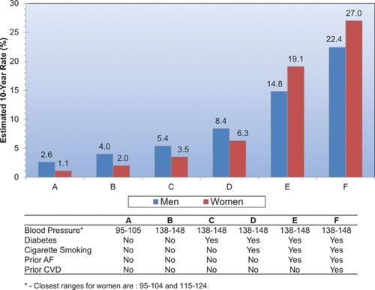

Stroke risk and co-morbidities
© 2015 American Heart Association, Inc.
Dariush Mozaffarian. Circulation. Heart Disease and Stroke Statistics—2016 Update, Volume: 133, Issue: 4, Pages: e38-e360, DOI: (10.1161/CIR.0000000000000350)

Slide 18
Sex Differences in Risk Factor Prevalence, Associations, and Treatment Disparities, Women Compared With Men
Risk Factor | Prevalence | Association With IS | Treatment Disparity
Hypertension | Lower in women (vs men) in younger age groups, higher in older age groups | Similar in women (vs men) in younger age groups, higher in older age groups | In younger age groups, women more likely to have BP controlled; in older age groups, women less likely to have BP controlled
Dyslipidemia | Data conflict; either similar between sexes or lower in women | Lower in women | Women less likely to be on statins and have LDL controlled
Atrial fibrillation | Higher in women | Higher in women | Women less likely to be prescribed oral anticoagulants, less likely to have cardiac ablation, and receive lower doses of NOACs
Migraine | Higher in women | Higher in women | Unknown if migraine treatment reduces stroke risk
Diabetes mellitus | Similar women vs men | Higher in women | Data conflict on sex differences in meeting HbA1c goal
Cognitive impairment | Higher in women | Unknown whether there is a sex difference | Women less likely to be treated with antidementia drugs
Madsen et al, Focused update- Impact of conventional risk factors on stroke in women: an update
Stroke 2018; 49, 3 : 536-542

Slide 19
Prognosis - Outcome
Post-stroke depression
Cognitive impairment
Age
Social factors, loneliness
„unhappiness stroke“?
Stress and vascular disease?
Gall S et al : Focused update in Patient Reported Outcome measures Stroke 2018;49:531–53

Slide 20
Outcome - Stroke Recurrency
More severe strokes
Higher recurrency stroke - atrial fibrillation ¹
Less aggressive treatment in women
„Underscreened“ ?
¹ Hong Y et al. Front Neurol.2017;8: 166

Slide 21
Lack of Evidence
Underrepresentation of women in randomized clinical trials ¹
Exclusion of older women
Lack of sex –specific analysis ²
¹ Tsivgoulis et al Ther Adv Neurol Disord. 2017;10(5):241-4.; ² Carcel et al Int J Stroke. 2019 Dec;14(9):931-938.

Slide 22
Future Directions
Sex as a variable prospectively ¹
Sex-specific analysis
Include females of all ages into trials
Risk factors – screening- prevention- follow-up
¹ Azarpazhooh M et al Assess study J neurol sciences 2019;399:209-213

Slide 23
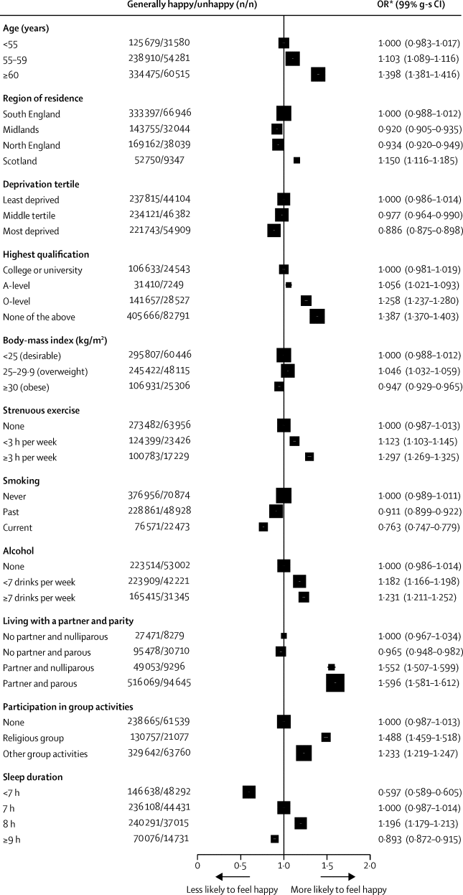
Does happiness itself directly affect mortality? The prospective UK Million Women Study
COVID?

Slide 24

Thank you for your attention!

Slide 25
In the future
1. A higher mortality of stroke in women is expected
2. A higher mortality of stroke in men is expected
3. A lower mortality of stroke in young women is expected
4. More younger men will suffer a stroke

Slide 26
What could be the reason for a treatment delay regarding acute stroke treatment in older women?
Women are less likely to call an ambulance
Men are not aware if their partner has a neurological deficit
Older women tend to live alone
Women are usually not connected to on-call emergency systems

Slide 27
A 35 year old women is presenting with headache and sensory loss of left side
The patient´s history has to be completed by migraine w/ aura and treatment with hormonal therapy
You can wait with acute stroke treatment with a positive history of migraine w/aura
You have to take a pregnancy test first
You have to complete patients history and perform imaging as soon as possible

Slide 28
Regarding the outcome after intravenous thrombolyis the following statement is true
Is better for women regarding mortality and morbidity after 3 months
Is better for men regarding mortality
Is worse for women regarding mortality
Is worse for women regarding mortality and morbidity

Slide 29
Which of the statements regarding stroke risk and atrial fibrillation is true?
1. Women have a higher percentage of atrial fibrillation and therefore a higher stroke risk
2. Men have a higher percentage of atrial fibrillation and a higher stroke risk
3. Women with atrial fibrillation have a higher stroke risk
4. There are no sex differences

Slide 30
Which of the statements is true?
1.Intracerebral hemorrhage is more common in men
2.Subarachnoid hemorrhage is more common in men
3.Ischemic stroke is more common in younger women
4. Older women are more likely to have lacunar strokes

Slide 31
Which risk factors have a higher association with ischemic stroke in women?
1.Diabetes and atrial fibrillation
2. Diabetes, atrial fibrillation, smoking, and migraine
3. Diabetes,blood pressure, and migraine
4. Blood pressure and smoking

Slide 32
Women can have a higher risk of stroke recurrency
1.Inadequate dosage ex. DOAC for atrial fibrillation and undertreatment
2.Lack of follow-up and monitoring
3.Worse compliance
4. No regular contact with a physician

Slide 33
You are the principal investigator of a randomized stroke trial and see that 70% of the included patients are men
What do you do?
Just wait - in the future there also will be women included
Adapt your recruitment strategy so it will be possible to include women pro-actively
Give feedback to the sponsor that global recruitment policy is changed
Exclude men regarding the next 10 randomizations

Slide 34
The worse long-term outcome after stroke in women can be due to
1.More co-morbidities
2.Older age and more co-morbidities
3.Higher percentage of cognitive decline
4.Higher percentage of post-stroke depression,older age,co-morbidities, and cognitive decline

Slide 35
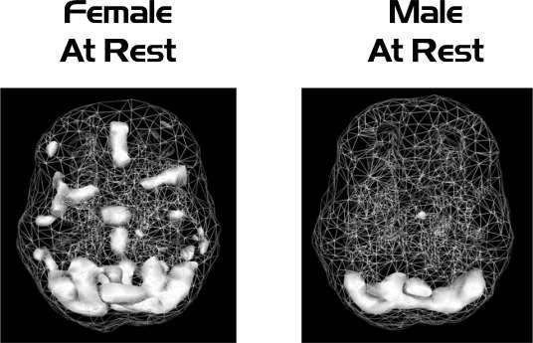

Slide 36
